Slide 1
Project 2 Diabetes KNN, Logistic Regression, SVM
Done by:
Mohammad Kharoof
Obada Issa
Yara Rashed

Slide 2
Introduction
Diabetes is a disease that occurs when your blood glucose, also called blood sugar, is too high. Blood glucose is your main source of energy and comes from the food you eat. Insulin, a hormone made by the pancreas, helps glucose from food get into your cells to be used for energy. Sometimes your body doesn’t make enough—or any—insulin or doesn’t use insulin well. Glucose then stays in your blood and doesn’t reach your cells.
Data science has improved exponentially over the last years and it has opened the doors to multiple ways of engineering all of that data. One way was to apply machine learning to the data in order to predict something based on an existing dataset in a set of algorithms called unsupervised machine learning algorithms.
Some examples of these algorithms are K Nearest Neighbors(KNN), Logistic Regression, and Support Vector Machine(SVM). These are classifier algorithms. They basically classify each datapoint to its own class or label. It depends on feature engineering and parameters selections.
Smart Bridge has offered us the Diabetes dataset which has 768 datapoints and 8 features with one label which is the Diabetes.
Our job is to process this dataset, clean it, visualize it, and come up with 3 models that can predict if a patient has diabetes or not.

Slide 3
Overview of the Project
As mentioned before, this dataset has multiple features which discuss the possibility of having diabetes.
These recorded features contained the following:
Pregnancies;
Glucose;
Blood Pressure;
Skin Thickness;
Insulin;
BMI;
Diabetes Pedigree Function;
Age;
Diabetes.
Fortunately, this dataset has no null values. Hence, we can skip the null values handling. However, there are some outliers and therefore, we will use the MinMaxScaler to clean the data.
After that our dataset is ready, we start with the analysis and see which visualizations are needed to see through the dataset to predict the outcome of the models.

Slide 4
Emphasis on the Problem
In the United States, the estimated number of people over 18 years of age with diagnosed and undiagnosed diabetes is 30.2 million. The figure represents between 27.9 and 32.7 percent of the population.
Without ongoing, careful management, diabetes can lead to a buildup of sugars in the blood, which can increase the risk of dangerous complications, including stroke and heart disease.
Different kinds of diabetes can occur, and managing the condition depends on the type. Not all forms of diabetes stem from a person being overweight or leading an inactive lifestyle. In fact, some are present from childhood.

Slide 5
Objectives
To process the dataset provided.
Clean it from all outlier values.
Visualize and understand the dataset.
Apply KNN on the dataset.
Apply Logistic Regression on the dataset.
Apply SVM on the dataset.
Compare all models based on factors such as Accuracy Score, Confusion Matrix, Precision Score, Recall Score and ROC_AUC_Score.

Slide 6
Dataset Description
The dataset includes various input features like:
Pregnancies: numeric.
Glucose: numeric.
BMI: numeric.
Diabetes: Binary class. Also, our target.

Slide 7
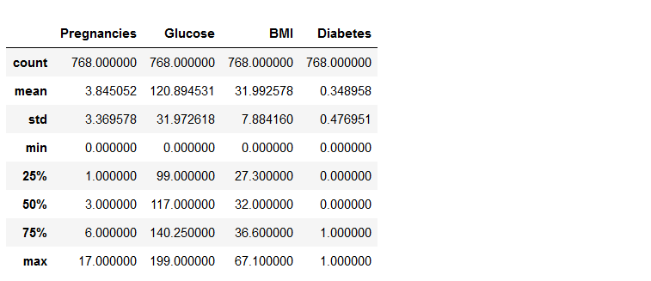
EDA
Notes:
Count: How many values were recorded.
Mean: mean.
std: standard deviation.
Min: minimum value.
25%: 25th percentile
50%: 50th percentile
75%: 75th percentile
Max: maximum value.

Slide 8
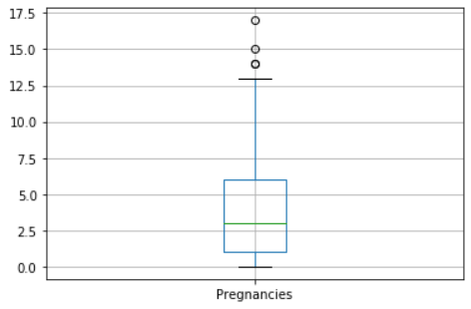
EDA
Boxplot for the Pregnancies.

Slide 9
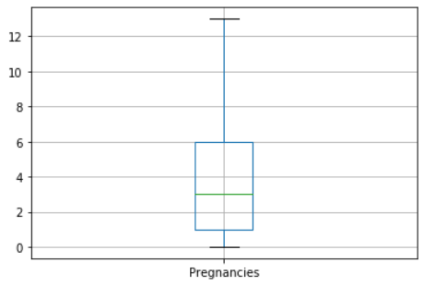
EDA
After getting rid of the outliers.

Slide 10
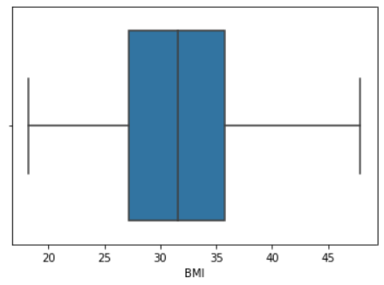
EDA
Analyzing the outliers of BMI through a boxplot.

Slide 11
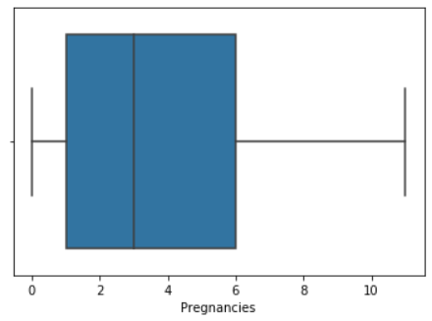
EDA
Analyzing the outliers of Pregnancies through a boxplot.

Slide 12
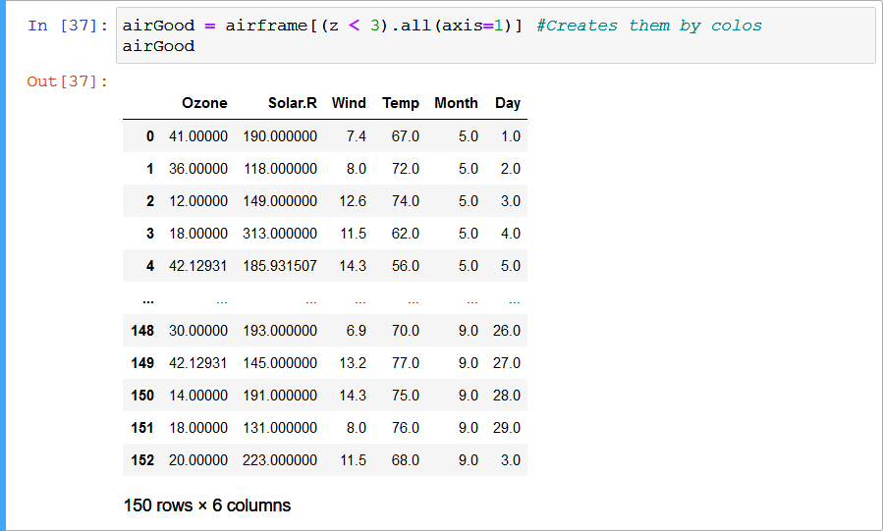
EDA
Cleaning using the z-score with threshold of 3. The output has lost 3 arrows of outliers which is a good sign. However, IQR might be able to do more.

Slide 13
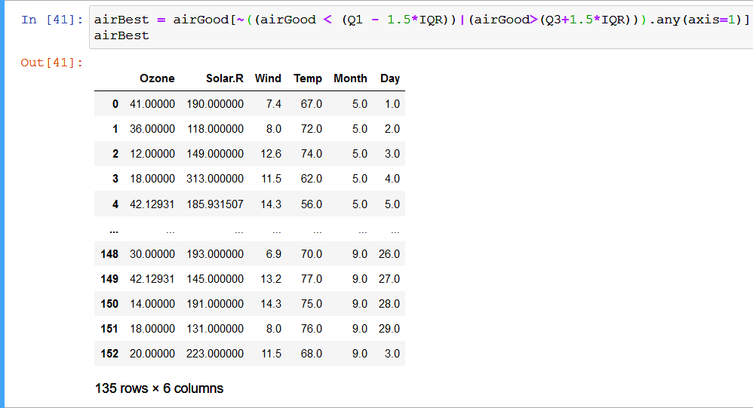
EDA
Cleaning using the IQR. The dataset has lost about 18 datapoints which were noisy outliers. Now, we are almost prepared to start with machine learning.

Slide 14
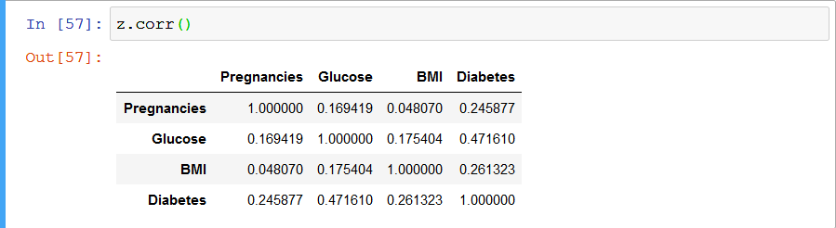
EDA
The correlation between every value in the dataset. This is so important as it tells us which value will impact the other values the most.

Slide 15
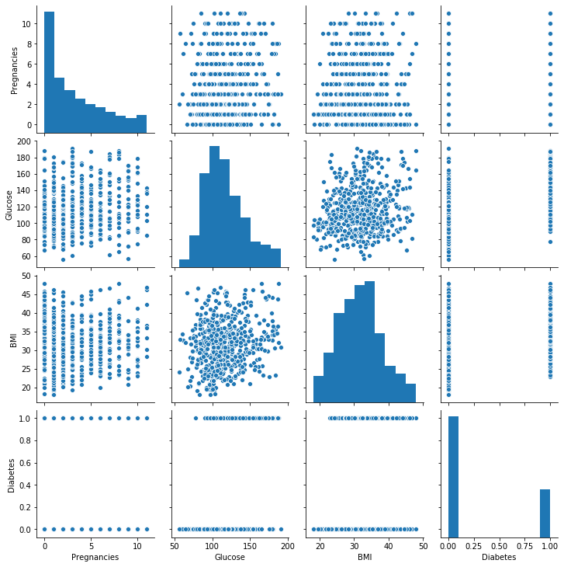
EDA
No correlation at all. Hence, the accuracy of the models will be bad.

Slide 16
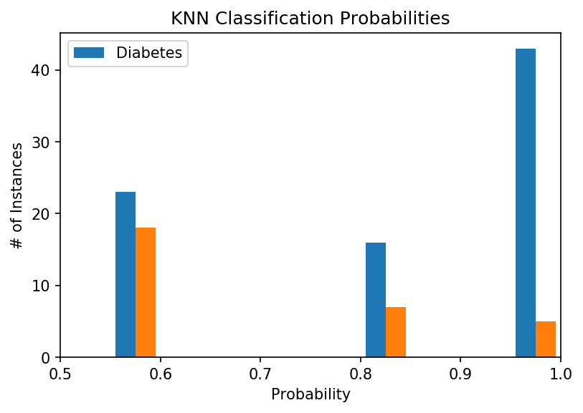
ML
Bar graph to represent the classification probabilities.

Slide 17
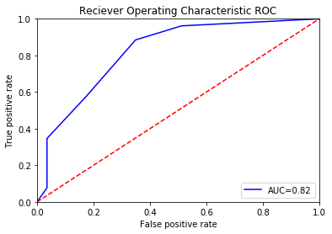
ML
ROC graph. Since it is not crossing the y=x line then we are good. Area Under the Curve (AUC) = 0.82 which is good for this ROC graph.

Slide 18
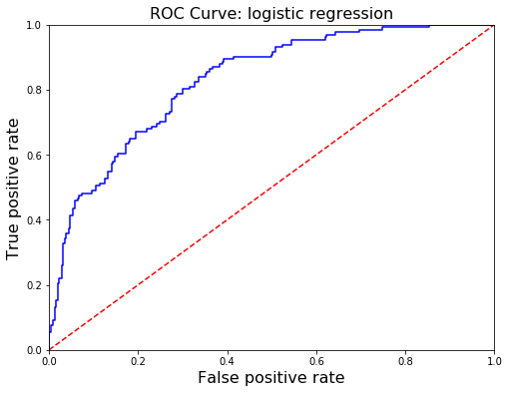
ML
ROC graph. Since it is not crossing the y=x line then we are good. Area Under the Curve (AUC) = 0.83 which is good for this ROC graph.

Slide 19
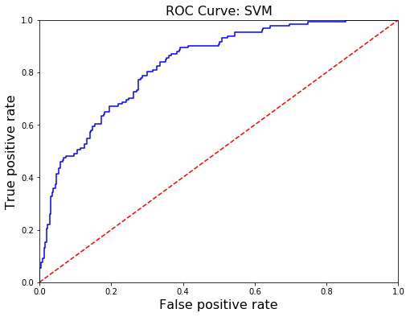
ML
ROC graph. Since it is not crossing the y=x line then we are good. Area Under the Curve (AUC) = 0.83 which is the same as the Logistic Regression.

Slide 20
ML
Results:

Slide 21
Summary and Findings
It can be seen from the very beginning, the relationship all features have with that one label.
We have data that is not collated at all.
We have then tried to include 3 features to the 3 models we had.
This dataset was simple to clean and visualize due to its low number of features. However, It is believed that more data is needed that has more correlation to further improve the accuracy.
SVM was the best in here but it is most probably due to randomness in the training.

